Slide 1

T.A.M.A Tourism Advocacy & Management Apparatus
- Aashish Kumar Shrestha [01/BCT/071]
- Bishodeep Dahal [100/BCT/071]
- Ribesh Maharjan [115/BCT/071]
- Sabal Gautam [119/BCT/071]

Slide 2
INTRODUCTION
Tourism is a major economic source for Nepal.
TAMA is a action toward introducing technology in field of tourism.
A recommendation system based on of historical data of tourists .
Informative system with description for many places of Nepal.

Slide 3
PROBLEM STATEMENT
Suggestions obtained from their friends or travel agencies.
Traditional sources are user-friendly; however, they have limitations.
Internet provides the possibilities , but time consuming and overwhelming.
Notes:
people obtained suggestions for their personal tourism from their friends or travel agencies .
Limitations : the suggestions from friends are limited to those place they have visited before
: the information from travel agencies is sometime biased since agents tend to recommend businesses.
internet information is too overwhelming and the users have to spend a long time finding those that they are interested in.
To give user an efficient and fast recommender alongside a proper website and an an- droid application
:

Slide 4
OBJECTIVES
Recommendation System based historical records and interests.
A platform for tourists to explore and learns about their destinations.
Easier approach to tourists to get information and affordable alternatives.
Useful information archived from past data and records.
Notes:
- To provide

Slide 5
FEATURES (Website)
Provides proper tourism recommendations based on previous data.
Able to view and review for destinations.
Searching the places with tags, names with semantic analysis.
Gallery with latest images and information.
Relation and interaction with Android Application.
Notes:
view and review the level of difficulty and ratings for destinations.

Slide 6
FEATURES (Android App)
Hotels and Lodge information.
User related profiles and information.
Currency conversion.
Weather forecasting.
Routes and maps (if available).
Relation and interaction with Website.

Slide 7
SYSTEM REQUIREMENTS
SOFTWARE REQUIREMENTS
Operating System and Android Platform with minimum API 22.
Android Studio.
Framework:ASP.net
MSSQL and SQLite
HARDWARE REQUIREMENTS
Fully functioning PC
Android Device supporting required API level

Slide 8
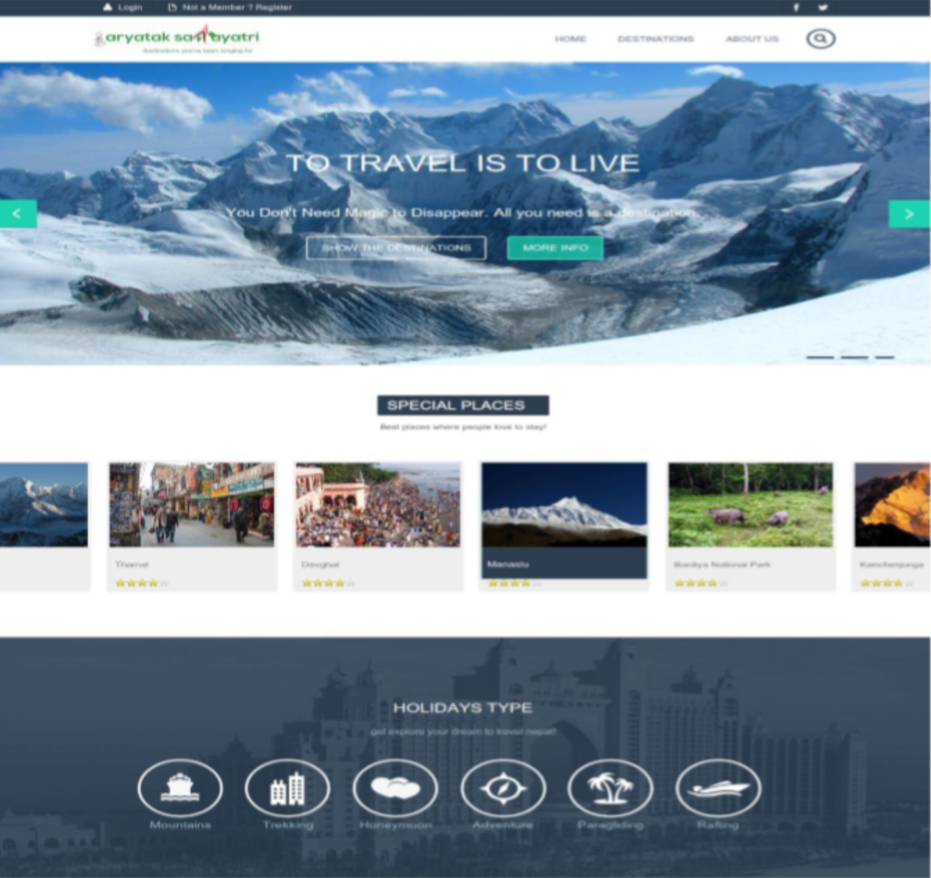
LITERATURE REVIEW (Previous Works)
Paryatan Sahayatri
Recommendation System based on their interests.
Main aim of was to promote tourism.
Notes:
-doesn’t have Searching the places with tags, names with semantic analysis.
-

Slide 9
LITERATURE REVIEW (Related Systems)
Match Maker : locate movies with mood, genre or cast to a given movie.
We Predict : Recommends movies based on previously indicated interests.
Amazon : Recommends products to user based on similar buying behavior.
Notes:
Match maker: allows customers to locate movies with a similar mood, theme, genre or cast to a given movie.

Slide 10
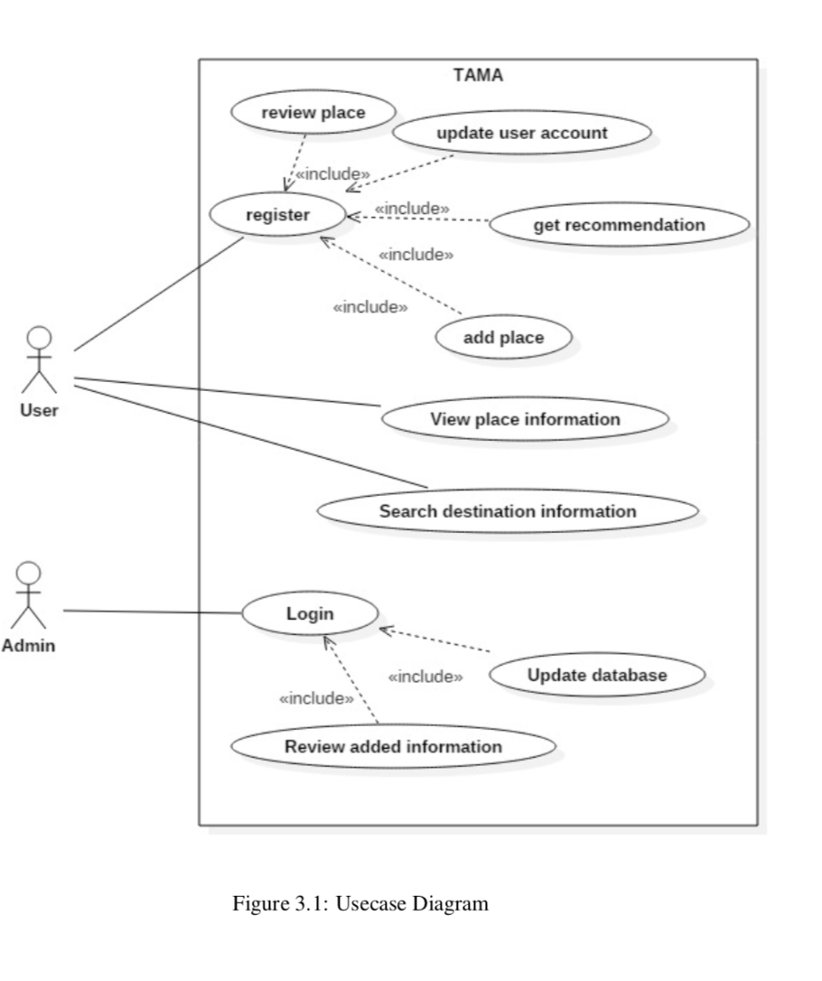
METHODOLOGY

Slide 11
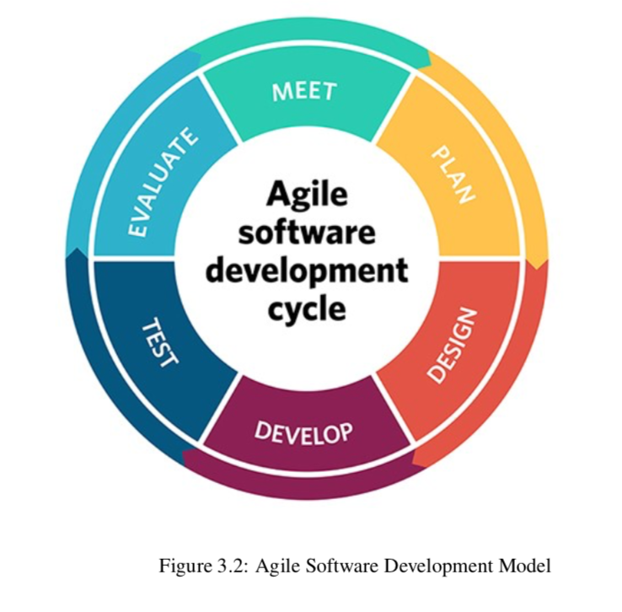
METHODOLOGY (Software Development Model)
Combination of iterative and incremental process models.
Product broken into small incremental builds which are provided in iterations.
Involves teams working simultaneously on various areas like:
• Planning • Requirements Analysis • Design • Coding • Unit Testing • Acceptance Testing.
Notes:
-Agile Software Development life Cycle(SDLC)model is a combination of iterative and incremental process models with focus on process adaptability and customer satisfaction by rapid delivery of working software product.
Agile Methods break the product into small incremental builds. These builds are provided in iterations. Each iteration typically lasts from about one to three weeks.

Slide 12
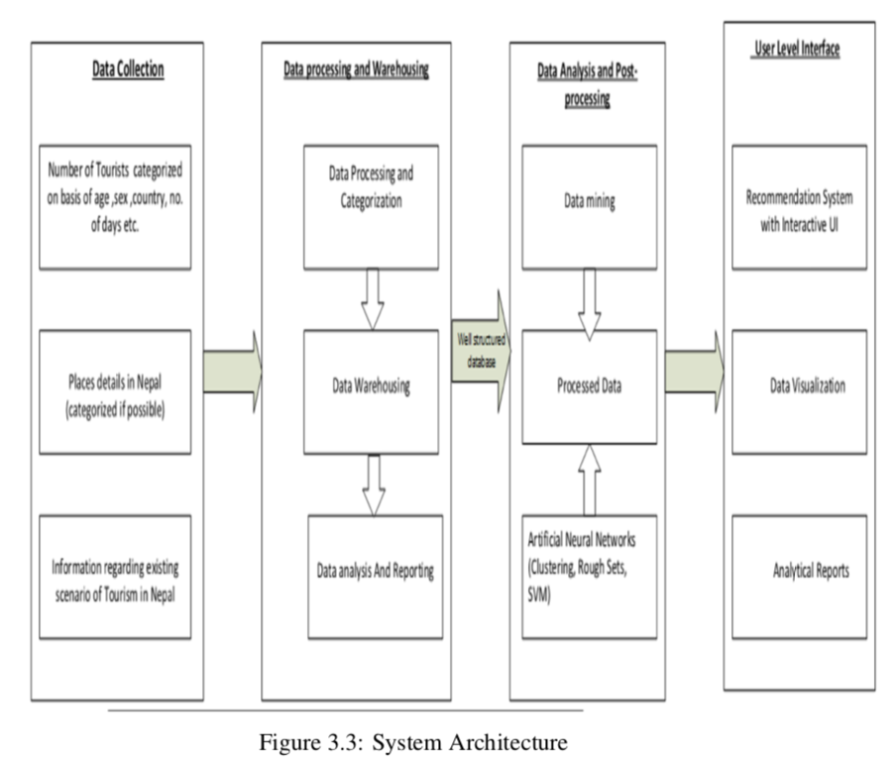
METHODOLOGY (System Architecture)
Data Collection
Data Analytics and Reporting
Data Mining
Clustering
Notes:
data with different schema is need to collected and transformed such that it is all kept under one common schema.
information are acquired and analyzed, and presenting the information in the systematic and well organized format is called reporting.
Data mining also known as knowledge discovery process, is the computational pro- cess of discovering patterns in a large data sets involving methods at the intersec- tions of the artificial intelligence, machine learning, statistics and database system.[3] The basic steps in this involves the
• Pre-processing • Algorithm analysis and implementations • Pattern evaluation and knowledge presentation
• Decisions
- is the process of dividing objects into groups whose members are similar in some way(s).

Slide 13
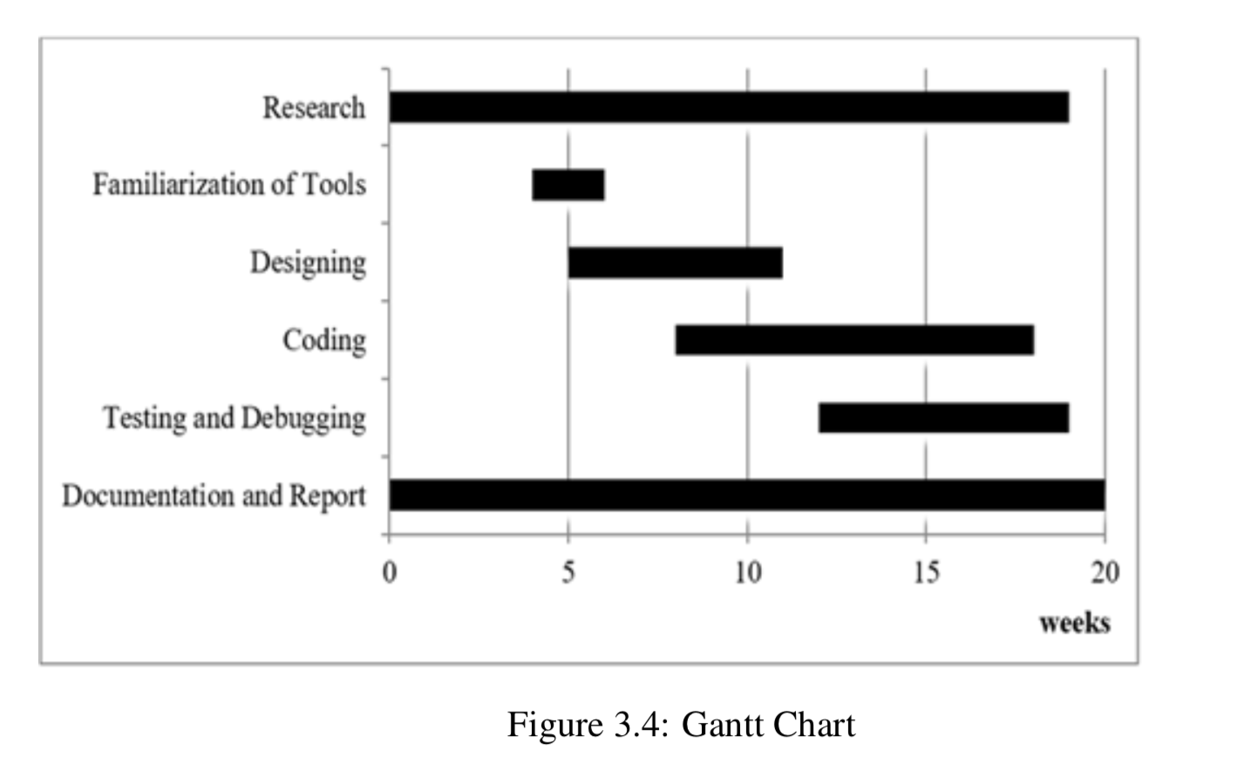
WORK SCHEDULE

Slide 14
THANK YOU !!!

